Slide 1
Application 3: Social Network Analysis
Il-Chul Moon Dept. of Industrial and Systems Engineering KAIST
icmoon@kaist.ac.kr
Notes:
Today, we are going to learn about the field of social network analysis.
However, it is actually based on the same technique as network analysis if you simply subtract the word, “social.”
Let’s get started with social network analysis, which is a representative application.

Slide 2
Weekly Objectives
This week, we study social networks and society structures.
Understand the basics in social networks and society structures.
Standard analytical techniques
Measures and algorithms
Understand the basic topologies of social networks and society structures
Notes:
What we should learn today is how a social network and social structure are defined.
One of the commonly used networks in industrial engineering is a supply chain.
We will practice its optimization when we work on practice exercises later.
Social network techniques enable us to conduct various analyses on them.
As this week is dedicated to applications, there isn’t much to cover, but it is important to understand basic concepts.
There are a number of basic techniques for social network analysis, as well as an algorithm for clustering.
We’ve examined graph structures when we were studying data structures. We’ll compare graph structures to networks to better our understanding.
We’ve studied algorithms related to graph structures without using too many examples.
We will also explore what is a topology, a frequently observed structure in the real world.

Slide 3

What is a social network?
Relations among people
Nodes are people, and links are relations.
Difference between network and graph
Graph: binary matrix
Network: weighted matrix
Notes:
First, we shall find out what is a social network.
In a nutshell, a social network is a relationship set of people.
Thus, a person can be considered to be a node, and relationships are links between these nodes.
For instance, we would use a link to refer to a friendship in Facebook or Twitter.
From this perspective, there is no significant difference between graphs and networks.
We can express a graph as a binary matrix.
This adjacency matrix consists of 0 and 1 only, which is why it’s called a binary matrix.
When it is a weighted matrix, meaning that the elements of the adjacency matrix include float numbers greater than 0, it is called a network.
The graph is distinguished from network, depending on what types of weight it uses.
For graphs, we use terms such as vertex and edge.
As for networks, we use terms such as node and link.

Slide 4
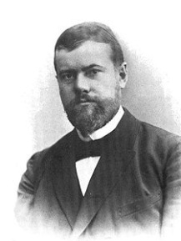


Organization and Society
Max Weber One of the three principal architects of modern social science
Let’s go back to the father of modern sociology!
Max Weber (1864-1920) think
An institution to control individuals in the interest of the organization leaders’ goals (Weber, 1978)
Leader? Control? Individuals?
Institution=System=Tool?
Okay, then where are the links?
Social Class and Hierarchy
Notes:
There are different perspectives regarding the beginning of a social network by different fields.
Social networks are also the subject of computer science or physics.
Different fields entail different viewpoints.
In my opinion, if we are to adopt a perspective closer to sociology, we need to begin with the story of Max Weber.
Max Weber is the father of modern sociology. The arguments that he proposed are as follows.
Social systems control individuals in the interest of the organization leaders’ goals.
Take the following as an example.
There is a leader who uses a the social system to manages people below him to promote his own interests.
Here is a social hierarchical structure.
Now, how does this leader control each individual?
In this context, is this institution both a system and tool?
If that is all we have, such a structure is nothing more than a declaration.
Let’s consider how to analyze this institution in a more scientific manner.
What if we express it as a network?
It is not easy for the CEO of a company to get in touch with new hires.
He or she would only make contact with those under his direct supervision.

Slide 5



Modern View on Organizational Structure
Social networks as a metaphor of a social system
Leader at the center. Minions as pendants
Barnes, 1954
Started focusing on the patterns of ties
Pattern between bounded groups and social categories
March and Simon, 1958
Organization analysis
From the social structure viewpoint
They started to see social networks as social structures.
Notes:
The following is how researchers would examine an organization from a modern viewpoint.
There is a social hierarchy.
Considering how this hierarchy manages individuals with a system, a leader is at the center surrounded by his subordinates. Here, we’ll call them minion.
There are interconnected links in between these people. When information is not released via the link, the information would not be delivered.
In this way, the organizational management in the modern era involves the flow of information. This flow is controlled and turns into a system managed for the leader’s purposes. Organization management involves the study of analyzing such structures.
For instance, Barnes asserted that it was necessary to focus on the patterns of ties in 1945.
He proposed a study on how a certain pattern of ties is generated in the course of passing over a category or how a tie is formed within a boundary.
Also, March and Simon proposed a theory about organizations in 1958.
Their theory was based on a social structure viewpoint.
They translated hierarchical factors in terms of the flow of information or money into networks to quantitatively examine a social structure viewpoint.
Here, a social network is used to indicate a way to express a social structure. It is employed here for a social network analysis.

Slide 6
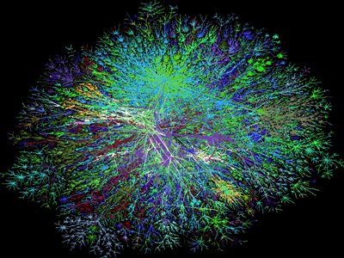
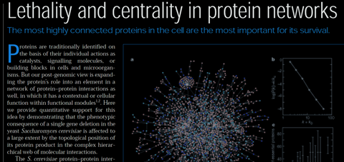
New Breeds in SNA
Albert, Jeong, and Barabasi (1999)
Internet and world wide web
Computer Scientists
Protein structures and material structures
Biologists and Physicists
Their common interests?
Jeong, Mason, Barabasi, and Oltvai (2001)
Notes:
Recently, various fields have adopted social network analysis methods.
Here, Jeong refers to Professor Jeong Ha-woong of KAIST’s Physics Department.
These people in the 1950s drew networks with a few number of people against a social structure. This one here, however, shows a computer server network.
It is an investigation of the network structure.
It began examining various biological processes, likening social network analysis methodology to the internal network of proteins.
Although social network analysis methodology was originally employed for investigating social relations, it has also been applied to computer networks, protein structure network analysis, etc.
It could also be adopted for supply chain and supply network analysis

Slide 7
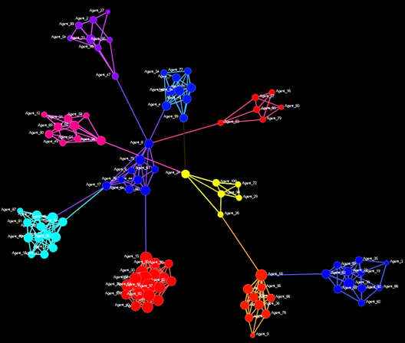
Key Techniques in Social Network Analysis
So, they started to see social networks as social structures.
Then, how to find the leaders, the organizations, and the system?
Measures
Required by sociologists looking for a key personnel
Clusters
Required by sociologists
looking for a sub-group
Dynamics
Triadic closure and strength of weak ties
Notes:
Let’s look over the core techniques of social network analysis.
Let’s suppose that there is a social network like this.
It is closely established within. Sometimes, the links extend to outsiders.
This is a commonly found pattern in a criminal network.
For example, this is a team.
It appears that they’re conspiring to commit a crime. The leader or two other people have broad connections that reach another group.
Although several people here are revealed, the entire network would not be uncovered as long as those in outside don’t say anything about the conspirators.
So, it then becomes a shadow network
Normally, this structure is called cellular network.
Let’s say that we regard such a social network as a social structure.
Then, how can we find out who is the leader and analyze the system?
There are several methods of quantitative analysis.
The first is to utilize a measure.
We would give a score called centrality to each point. We are going to consider node with the highest score as especially important.
Establishing a scoring system is one way to identify the leader.
To be able to calculate the scores, we have to have a full understanding of the network structure.
The next step is used to locate subgroups.
These people are categorized as a single team.
As such, people have been studying clustering methods.
Lastly, we need to consider dynamics.
We should learn the structure in to understand how some information may be concealed.

Slide 8
Centralities as Measures
From a suggestive metaphor to an analytic approach
Metaphor: This person at the center must be the leader!
Analytics: This person with a high score must be the leader!
We need Numbers, Scores!
Mathematical sociologists searched correlations between numbers and roles
Some numbers found to be useful became metrics and named as centralities
Degree centrality
Betweenness centrality
Eigenvector centrality
(Freeman, 1979; Bonacich, 1972)
Notes:
For the first technique, let’s take a look at centralities.
We need numbers to move from metaphors to analytic expression with numbers.
A metaphor has a declarative feature: for instance, this person at the center must be the leader.
For it is to be analytic, we need quantitative means as in: “the presence of such a high score proves this person to be the leader.”
In this regard, we have mathematical sociologists who analyze society by means of mathematical methods.
These scholars computed the correlation between specific scoring systems of their devices and the role of social structure.
Some of their scoring systems were proven to be very useful.
Thus, their findings were summed up as a score called centrality.
Widely used scoring systems include
degree centrality, betweenness centrality, Eigenvector centrality, and more.
Among them, we will focus on degree centrality and betweenness centrality.

Slide 9

Centralities: Degree Centrality
Simple! Counting the number of links
Local measure
Do not need the network-wise calculation
Approximate hubs in a network
I have four links.
Notes:
In fact, degree centrality is very simple.
We can figure out the score by counting how many links it has.
For example, this node has 3 links, that node has 4 links, and some nodes have 2 links or fewer.
A person whose score is 3 will have less significance than those who have a score of 4.
We can conjecture that these people are not in a position to manage the entire network.
As shown here, people whose score are 1 will be located at the very lowest level.
People with high scores are at the center of a network. Their very position allows them to manage the network. That’s because they have the advantage of being better able to observe the flow of information or resources.
However, these two people have the same score: 4.
We would say that their importance is similar to each other in terms of the number of connected links.
When we suppose this person gives out information to that person, however, there are a variety of methods available.
In these circumstances, when information flows, this node is always at present.
That is to say, how many links one has can be classified as a local measure.
As long as we know the local structure, we can determine the degree centrality.
But the problem in a local measurement is that the importance may change due to external structures.
In other words, a local measure can fail to reflect global effects.
However, it can be quickly computed as it only requires us to check the surrounding of nodes.

Slide 10
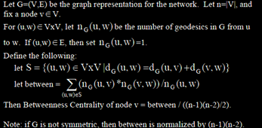
Centralities: Betweenness Centrality
Simple! Counting the number of all-pair shortest paths going through the node
Global measure
Need the whole network structure to calculate a value for a node
Interesting implications
Has been suggested as a information/influence transfer indicator
Ten shortest paths among APSPs go through me.
Notes:
Degree centrality, which we’ve discussed before, is a local measurement. Now we will calculate betweenness centrality, a typical global measurement.
It involves counting the number of times that all-pair shortest paths pass through this node.
An all-pair shortest path is used to find all the possible paths for the occasion when the person here sends information to all the people.
With 7 people in total with no specific direction, there are total 21 pairs.
Let’s name these 7 people, A to G.
As such, there are paths starting from A.
After we list all the paths, we would count how many times the people here appear in the path list.
As we may expect, the person named E would appear a lot.
Conversely, Person G will only have a path that goes to G.
We also have C, but it is not necessary to pass through this person.
As there are many paths that skip C, C will have less importance than E.
What we’ve learned about graphs can be applied here.
As such, calculating the importance with the shortest path is an indicator that could gauge how much information or influence is transferred. This can then be used for determining the betweenness centrality scores.

Slide 11
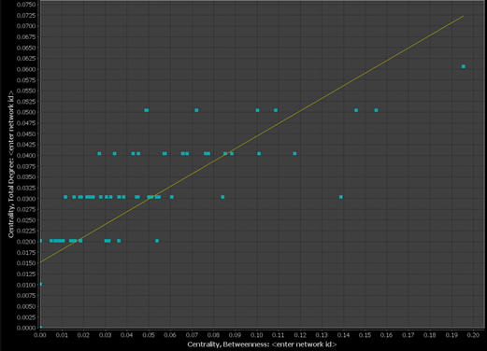
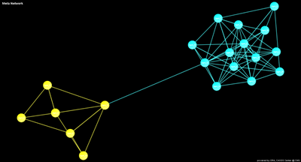
Low Degree and High Betweenness
High degree centrality people
Often, they are hubs. They are the elites.
High betweenness centrality people
Often, they are information brokers.
Then, low degree and high betweenness people?
They are not network elites, but they control information!
Bridging nodes!
Notes:
Earlier, we’ve studied how to get two types of centralities.
One is degree centrality, and the other is betweenness centrality.
Degree centrality is a local measure that counts how many links there are. Betweenness centrality differs in that is a global measure to gauge the frequency of an item on the shortest path.
A person with high degree centrality plays the role of a hub or an elite. He or she attracts a great deal of information.
People of high betweenness centrality are prone to assume the role of brokers who deliver something to different places.
Now, let’s try combining these two concepts.
The y axis represents degree centrality. The x axis denotes betweenness centrality.
People show these kinds of tendencies.
This person has higher betweenness than degree centrality, or lower degree compared to the same level of betweenness.
This type of person could be classified as “low degree, high betweenness.”
That means, we can identify a person’s characteristics by combining these scores.
These people become bridging nodes.
On the contrary, if this person disappears, the connection with this organization will be severed. Then, this person could actually be more important.
We’ve briefly reviewed two methods of calculating centralities.
Centrality is a popular research topic, and there are various types of centralities.
One of the important ways to analyze social networks is to discover the characteristics of certain nodes by combining centralities.

Slide 12

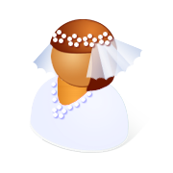

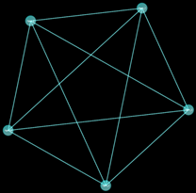


Clusters as Social Groups
How to divide the social entities into sub groups?
Graph theoretic groups
K-Cliques
Cohesive groups
Form a tightly linked components
Notes:
We’ve conducted individual analysis with centralities. Now let’s move on and learn about subgroups.
This is a clustering method.
There are several kinds of clustering methods, actually.
In graph theory, searching for a K-clique is one of the popular clustering methods.
Another method is to identify a cohesive group.
Similar to the property of glue, a “cohesive group, refers to a group that has a strong tendency to stick together.
There are other different methods as well.
To cite a few, some clustering methods are based on equal or different properties of nodes.

Slide 13
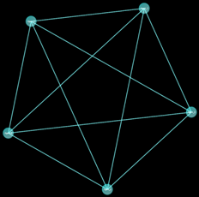
K-Clique
Clique in an undirected graph G
A set of vertices V such that for every two vertices in V, there exists an edge connecting the two.
Complete network
NP-Complete problem, only works in a small network or very small K
3-Clique
5-Clique
Notes:
First, we have a K-clique originated from a game theory.
We’ve briefly touched upon the K-clique when dealing with graphs.
If there is an undirected graph, we can define K-cliques in this manner.
A set of vertices, V, such that for every two vertices in V, there exists an edge connecting the two.
Thus, if there are interlinked subset Vs, they are called cliques.
It was also called complete network. We’ve covered this concept when we studied graphs earlier.
A complete network is a characteristic of this entire graph, whereas cliques are features of the subsets of a graph.
If a clique is promptly discovered, it is called NP-complete.
However, it is too theoretical to be handled in this lecture.
In an actual algorithm class, however, it would be called NP-complete.
NP-complete is possible in a very tiny network or when K is miniscule.
Nowadays, however, parallel methods are well developed, and the speed of a K-Clique search has been greatly accelerated.
The theory is still difficult, but the speed of performing the search is increasing due to advancements in computing power.
Let’s just find out what K-Clique is here.
As this graph is a complete network, and every node is interconnected, it is 5-node Cliques.
This is a fish-shaped network, which we’ve seen before.
Here, its clique is 3-cliques, like this.
There is no 4-cliques.
This part is not a clique.
That is because it does not have a cross link in this way.
Therefore, we were able to find out the subgroups based on graph theory by using the premise of K-cliques.

Slide 14

Newman Clustering
Girvan-Newman Algorithm (Girvan and Newman, 2002)
The betweenness of all existing edges in the network is calculated first.
The edge with the highest betweenness is removed.
The betweenness of all edges affected by the removal is recalculated.
Steps 2 and 3 are repeated until no edges remain.
Pretty nice tool to find a cohesive group
Highest Edge Betweenness
Notes:
Earlier, we tried a clustering method to find K-cliques, but there was another clustering technique that was widely used from the early 2000s.
It is called Newman clustering.
It is also called the Girvan –Newman algorithm.
This method is about applying the betweenness that we’ve covered before to edges.
For example, let’s say that person here would send information to that location.
If so, the shortest path for the case should look like this.
As this node is passed once, it is possible to be counted in the node level.
However, the edges here are also used. We can calculate the betweenness against edges.
So, we first obtain the betweenness for the edges.
Then, we eliminate the highest betweenness among them.
That makes so that all the people here should deliver by using this path in order to transmit information to this place.
This one will inevitably have the highest betweenness.
Therefore, we would cut this edge off first.
Then, it will be separated into two discrete components.
If so, they are called as subgroups.
This is how a Newman clustering technique is conducted.
This is very neatly done case: a single cut-off resulted in two different components.
We’ve already learned about the definition of a component during the week we studied graphs.
As you may recall, a component is a set of connecting vertices and edges.
We got two separate components by a single edge removal.
If it is not separated by a single removal, we should re-calculate the betweenness.
That is because the disappearance of edge leads to a change in betweenness. We calculate again and keep on removing with loops until the component is severed.
This is how we would find out subgroups. The former method distinguishes subgraphs within the network.

Slide 15
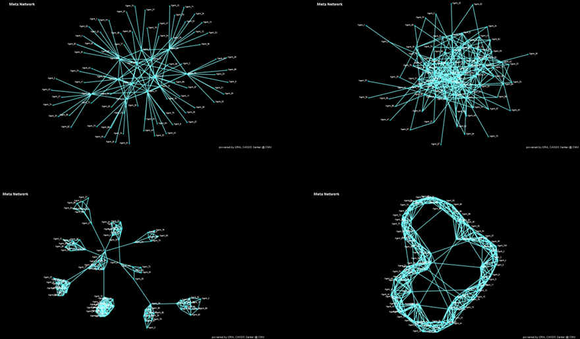
Network Visualization
Core-Periphery Network
Scale Free Network
Cellular Network
Small World Network
Notes:
Lastly, we will examine the network structure, and go beyond clustering.
In reality, there are a wide variety network structures.
The following are some examples of visualized networks.
For instance, we would call this a “Core-Periphery Network.”
While the nodes that form the core are closely interconnected, those falling into the outskirts—or the periphery—are only linked to the nodes at the core.
Consequently, those in the core are interconnected and exchange information. Those in the periphery are linked to a single node in the core.
This type of network is often observed in transactions among businesses.
The periphery could be viewed as subcontractors that carry out an exclusive transaction with a single conglomerate.
Large enterprises make transactions between one another.
Thus, those large enterprises form a core and are closely interconnected. Companies in the periphery are only connected to the ones in the core.
Another type of network is a scale-free network.
It is difficult to clearly define what a scale-free network is.
A scale-free network has a hub with a really high degree, while the number of nodes for a node is diminished. There are only two links for one node.
This is a cellular network.
Each node is intimately united, like cells. These cells are newly connected networks.
This is a small world network, featuring tight connections with nearby neighbors and very few connections between nodes that are far from each other.
However, there are infrequent nodes that crossing to each other to form a network.
To cite an example, we would observe this kind of network in a rural village. The villagers maintain close ties among themselves, while the school teachers also have wider, more interconnected networks.

Slide 16
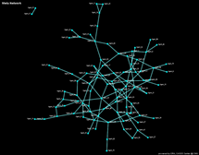
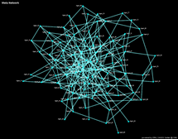
Network Density
Density: 0.025
Density: 0.05
One of the simplest metrics about network status
Things you need to report when you write a SNA paper
Number of nodes
Network Density
Sometimes
Network diameter
Pareto distribution parameter if the degree distribution follows the power-law
One trend
Social network density is usually very low.
Why?
One pendant node increase will induce huge network density drop.
Remember the adjacency matrix will grow O(n²)
Notes:
We should now understand the structure of networks as we’ve studied them before.
Although we could determine the structure of networks, it is not quantitative.
To qualify as quantitative, we need numbers.
For instance, to compare if one is denser or sparser to another, we need to quantify these characteristics as numbers.
A network density is the easiest measure we can use to understand the status of a network.
For example, if there is a paper on a social network analysis, it should have information on the number of nodes and network density.
In general, a social network density is generally very low.
That’s because its adjacency is O(N^2).
Therefore, the number of edges could not keep up with O(N^2), resulting in a low-density network.
We’ve covered how to calculate density during the week when we studied graphs.

Slide 17
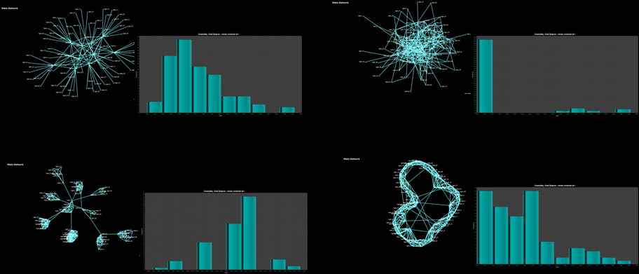
Degree Distribution
The overall shape of networks
How to statistically recognize a network topology?
Core-Periphery Network
Scale Free Network
Cellular Network
Small World Network
Notes:
A network structure can be expressed in a visualized form or density.
However, these representations are neither rigorous nor represented by a single number.
For a more accurate representation, or most rigorous expression, we need to draw a degree distribution.
This is a histogram.
And here, we have a frequency.
This is the number of degree.
They will make a histogram, showing how many degrees are under control.
In other words, this is the result of counting the number of nodes with 1 degree in this section.
In a scale-free network, we observe that there are heaps of nodes with 1 degree. There are quite a limited number of nodes with the degree of 2 or higher.
While a cellular network takes a shape like this, a small world network looks like this.
Therefore, it is possible to quickly determine the structure of individual networks by using a degree distribution.

